Slide 1
Experiment in
Compiler Construction
Scanner design
Department of Computer Science
School of ICT - Hanoi University of Science and Technology
Experiment in compiler construction - Scanner design

Slide 2
What is a scanner?
_{Lexical}
_{Analysis}
The compiler’s component/module that perform the job of lexical analysis (scanning) is called scanner.
Compiler’s first phase
_{Syntax}
_{Analysis}
_{Semantic}
_{Analysis}
_{Code}
_{Generation}
Experiment in compiler construction - Scanner design

Slide 3
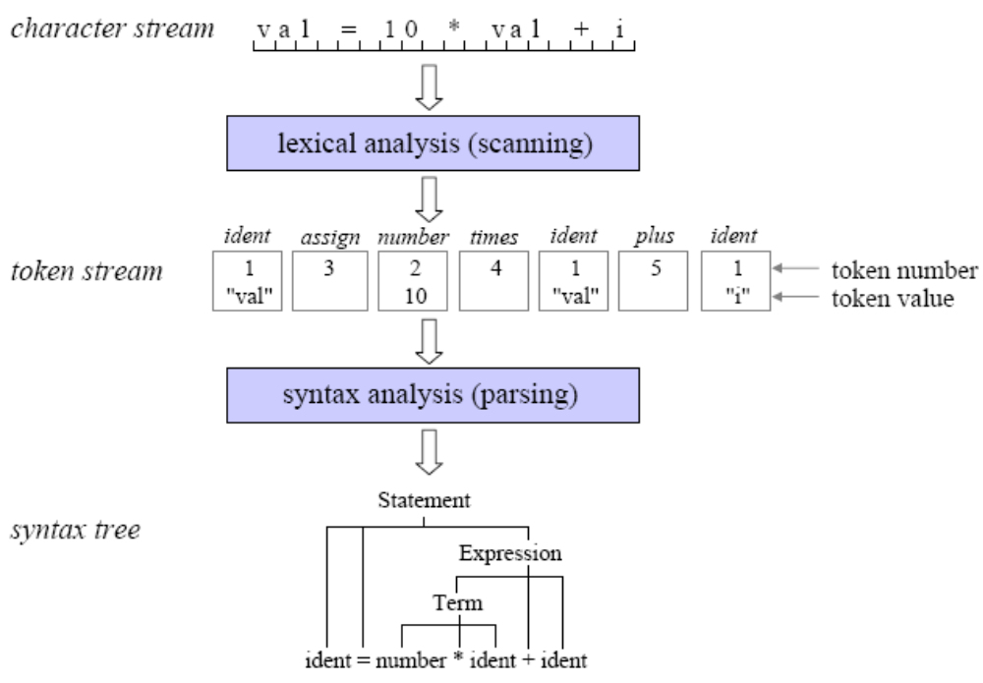
What is a scanner?
Experiment in compiler construction - Scanner design

Slide 4
Tasks of a scanner
Skip meaningless characters: blank, tab, new line character, comment.
Recognize illegal character and return error message
Recognize different types of token
  identifier
  keyword
  number
  special character
  ...
Experiment in compiler construction - Scanner design

Slide 5
Tasks of a scanner
Recognize tokens of different types
  identifier
  keyword
  number
  special character
  ...
Pass recognized tokens to the parser (the module that perform the job of syntatic analysis)
Experiment in compiler construction - Scanner design

Slide 6
KPL’s alphabet
Letter: a b c … x y z
A B C … X Y Z
Digit: 0 1 2 … 8 9
Special character:
  + - * /
  > < ! =
  [space] ,(comma) . : ; ‘ _
  ( )

Slide 7
KPL’s tokens
Keywords
PROGRAM, CONST, TYPE, VAR, PROCEDURE, FUNCTION, BEGIN, END, ARRAY, OF, INTEGER, CHAR, CALL, IF, THEN, ELSE, WHILE, DO, FOR, TO
Operators
:= (assign)
+ (addition), - (subtraction), * (multiplication), / (division)
= (comparison of equality), != (comparison of difference), > (comparison of greaterness), < (comparison of lessness), >= (comparison of greaterness or equality), <= (comparison of lessness or equality)
Experiment in compiler construction - Scanner design

Slide 8
KPL’s tokens
Special characters
; (semicolon), . (period), : (colon), , (comma), ( (left parenthesis), ) (right parenthesis), ‘ (singlequote)
Also
(. and .) to mark the index of an array element
(* and *) to mark the comment
Others
identifier, number, illegal charater
Experiment in compiler construction - Scanner design

Slide 9
Recognizing KPL’s tokens
All KPL’s tokens make up a regular language.
They can be described with regular grammar
They can be recognized by a Deterministic Finite Automaton (DFA)
The scanner is a big DFA
Experiment in compiler construction - Scanner design

Slide 10
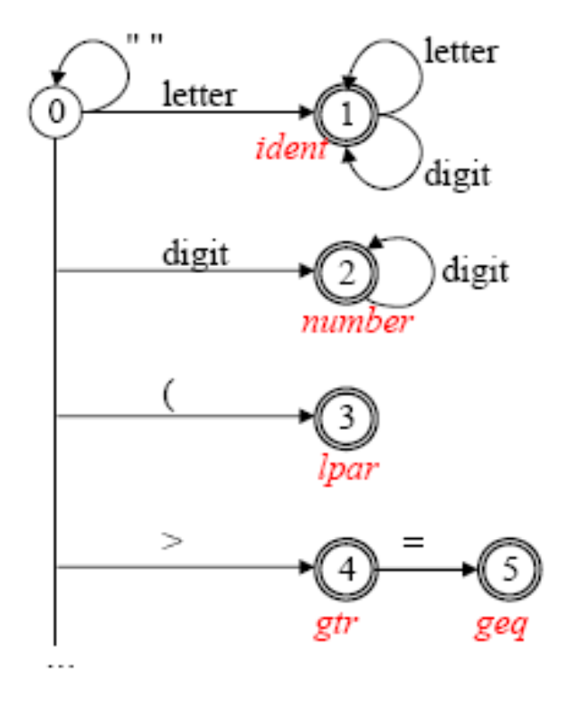
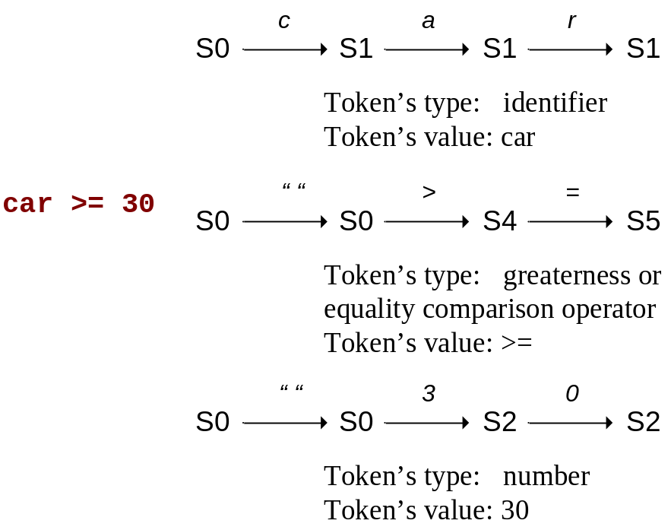
Recognizing KPL’s tokens
After every token is recognized, the scanner starts in state 0 again
If an illegal character is met, the scanner would change to the state -1 which tell the scanner to stop scanning and return error messages.
Experiment in compiler construction - Scanner design

Slide 11
KPL scanner - organization
# | Filename | Task
1 | Makefile | Project
2 | scanner.c | Main
3 | reader.h, reader.c | Read the source code
4 | charcode.h, charcode.c | Classify character
5 | token.h, token.c | Classify and recognize token, keywords
6 | error.h, error.c | Manage error types and messages
Experiment in compiler construction - Scanner design

Slide 12
KPL scanner – reader
// Read a character from input stream
int readChar(void);
// Open input stream
int openInputStream(char *fileName);
// Close input stream
void closeInputStream(void);
// Current line number and column number
int lineNo, colNo;
// Current character
int currentChar;
Experiment in compiler construction - Scanner design

Slide 13
KPL scanner – charcode
typedef enum {
CHAR_SPACE, // space
CHAR_LETTER, // character
CHAR_DIGIT, // digit
CHAR_PLUS, // ‘+’
CHAR_MINUS, // ‘-’
CHAR_TIMES, // ‘*’
CHAR_SLASH, // ‘/’
CHAR_LT, // ‘<‘
CHAR_GT, // ‘>‘
CHAR_EXCLAIMATION, // ‘!’
CHAR_EQ, // ‘=‘
CHAR_COMMA, // ‘,’
CHAR_PERIOD, // ‘.’
CHAR_COLON, // ‘:’
CHAR_SEMICOLON, // ‘;’
CHAR_SINGLEQUOTE, // ‘\’’
CHAR_LPAR, // ‘(‘
CHAR_RPAR, // ‘)’
CHAR_UNKNOWN // invalid character
} CharCode;
Experiment in compiler construction - Scanner design

Slide 14
KPL scanner – charcode
In charcode.c, we define charCodes array that associates every ASCII character with an unique predifined CharCode.
getc() function may return EOF (or -1) which is not an ASCII character.
Experiment in compiler construction - Scanner design

Slide 15
KPL scanner – token
typedef enum {
TK_NONE, // Invalid token - Error
TK_IDENT, // Identifier token
TK_NUMBER, // Number token
TK_CHAR, // Character constant token
TK_EOF, // End of program token
// keywords
KW_PROGRAM, KW_CONST, KW_TYPE, KW_VAR,
KW_INTEGER, KW_CHAR, KW_ARRAY, KW_OF,
KW_FUNCTION, KW_PROCEDURE,
KW_BEGIN, KW_END, KW_CALL,
KW_IF, KW_THEN, KW_ELSE,
KW_WHILE, KW_DO, KW_FOR, KW_TO,
// Special character
SB_SEMICOLON, SB_COLON, SB_PERIOD, SB_COMMA,
SB_ASSIGN, SB_EQ, SB_NEQ, SB_LT, SB_LE, SB_GT, SB_GE,
SB_PLUS, SB_MINUS, SB_TIMES, SB_SLASH,
SB_LPAR, SB_RPAR, SB_LSEL, SB_RSEL
} TokenType;
Experiment in compiler construction - Scanner design

Slide 16
KPL scanner – token
// Structure of a token
typedef struct {
char string[MAX_IDENT_LEN + 1];
int lineNo, colNo;
TokenType tokenType;
int value;
} Token;
// Check whether a string is a keyword or not
TokenType checkKeyword(char *string);
// Create new token, provided type of token and location
Token* makeToken(TokenType tokenType, int lineNo, int colNo);
Experiment in compiler construction - Scanner design

Slide 17
KPL scanner – error management
// List of error may occur in lexical analysis
typedef enum {
ERR_ENDOFCOMMENT,
ERR_IDENTTOOLONG,
ERR_INVALIDCHARCONSTANT,
ERR_INVALIDSYMBOL
} ErrorCode;
// Error message
#define ERM_ENDOFCOMMENT "End of comment expected!"
#define ERM_IDENTTOOLONG "Identification too long!"
#define ERM_INVALIDCHARCONSTANT "Invalid const char!"
#define ERM_INVALIDSYMBOL "Invalid symbol!"
// Return error message
void error(ErrorCode err, int lineNo, int colNo);
Experiment in compiler construction - Scanner design

Slide 18
KPL scanner – scanner
// Get next token
Token* getToken(void) {
Token *token;
int ln, cn;
if (currentChar == EOF)
return makeToken(TK_EOF, lineNo, colNo);
switch (charCodes[currentChar]) {
case CHAR_SPACE: skipBlank(); return getToken();
case CHAR_LETTER: return readIdentKeyword();
case CHAR_DIGIT: return readNumber();
case CHAR_PLUS:
token = makeToken(SB_PLUS, lineNo, colNo);
readChar();
return token;
case … // more cases
}
}
Experiment in compiler construction - Scanner design

Slide 19
Assignment
Complete following function in scanner.c
  void skipBlank();
  void skipComment();
  Token* readIdentKeyword(void);
  Token* readNumber(void);
  Token* readConstChar(void);
  Token* getToken(void);
Experiment in compiler construction - Scanner design

Slide 20
getToken() (1)
Program ⇒ getToken() ⇒ TokenType: token
|- digit readNumber()
|- letter readIdentKeyword()
|- blank skipBlank()
| getToken();
|- ( |- . SB_LSEL
|- * skipComment()
| getToken();
|- other SB_LPAR
|- ‘ readConstChar()
|- < |- = SB_LE
|- other SB_LT

Slide 21
getToken() (2)
Program ⇒ getToken() ⇒ TokenType: token
|- > |- = SB_GE
|- other SB_GT
|- ! |- = SB_NEQ
|- other error: INVALIDSYMBOL
|- . |- ) SB_RPAR
|- other SB_PERIOD
|- : |- = SB_ASSIGN
|- other SB_SEMICOLON
|- + - * / = , ; ) SB_...
|- other error: INVALIDSYMBOL

Slide 22
readNumber()
readNumber()⇒ TokenType: token
readChar()
|- digit readChar()
|- other TK_NUMBER
  Use atoi() function to convert a string to an integer.

Slide 23
readIdentKeyword()
readIdentKeyword() ⇒ TokenType: token
readChar()
|- digit, letter readChar()
| count ++
|- other
|- count > MAX_IDENT_LENT
| error: IDEN_TOO_LONG
|- count ≤ MAX_IDENT_LENT
|- ≡ keywords KW_...
|- ≠ keywords TK_IDENT

Slide 24
skipBlank()
skipBlank()
|- blank readChar()
|- other return

Slide 25
skipComment()
skipComment()
inside_comment |- * |- ) return
|- other inside_comment
|- EOF error: END_OF_COMMENT
|- other inside_comment
|- EOF error: END_OF_COMMENT

Slide 26
readConstChar()
readConstChar()⇒ TokenType: token
|- character
|- ‘ TK_CHAR
|- other error: INVALID_CONST_CHAR
|- EOF error: INVALID_CONST_CHAR

